Slide 1
Dr.KHAWLA Bouafia
Telecommunication Network – Practice-
Notes:
VirtualBox

Slide 2
Dr. Khawla Bouafia
Department of Information System
Eotvos Lorand University (ELTE)
Budapest, Hungary
Email: bouafia@inf.elte.hu
Office: 2-519

Slide 3
Practice 11
Notes:
VirtualBox ,topologies and Interact with Hosts and Switches

Slide 4
Install Mininet VM
Download VirtualBox:
https://www.virtualbox.org/wiki/Downloads
Download Mininet VM:
https://github.com/mininet/mininet/releases/download/2.2.2/mininet-2.2.2-170321-ubuntu-14.04.4-server-amd64.zip

Slide 5
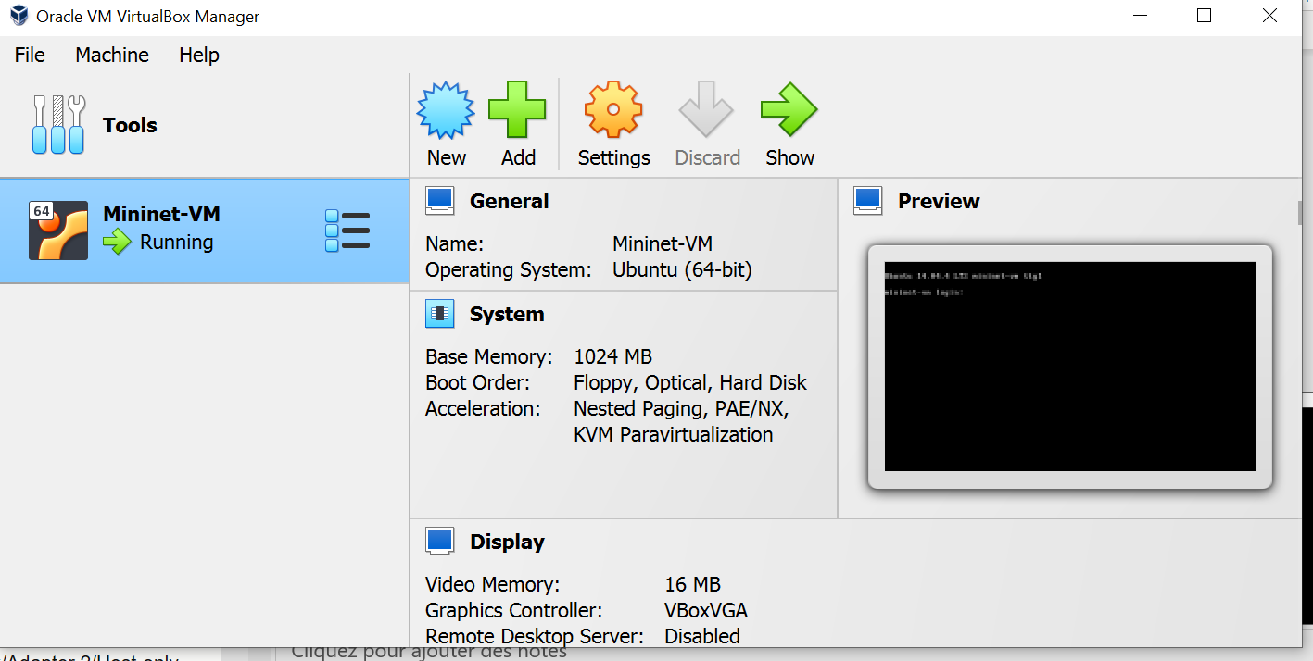
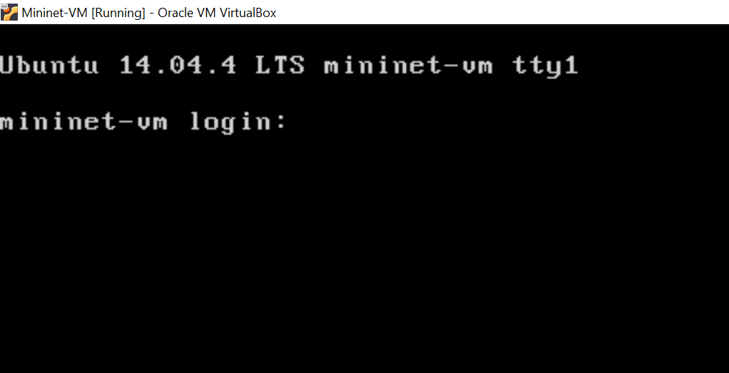
Install Mininet VM
Open VirtualBox
Click „Import” then open the image downloaded
New image on left: Mininet-VM
Click „Run”
System should boot up
Login: mininet
Password: mininet

Slide 6
Install Mininet VM
Shutdown the VM
Mininet-VM/Settings/Network/Adapter 2/Host-only adapter
Reboot
Ifconfig –a
Copy the IP of „eth0”: 192.168.xxx.xxx
This is the local IP of our VM. We can later connect to it through WinScp, Putty etc..

Slide 7
Install Mininet VM
Problem: We will use xterm which needs a graphical interface (X11 server)
To install the GUI:
sudo apt-get update && sudo apt-get install xinit lxde virtualbox-guest-x11
sudo startx
Now Linux should boot up with a GUI

Slide 8
https://vdocuments.net/teaching-computer-networking-with-mininet.html?page=31

Slide 9
Topologies in Mininet
The default topology in Mininet consists of two hosts and two switches.
There are many other topologies available in mininet, such as:
single
Reversed
linear
tree
torus

Slide 10
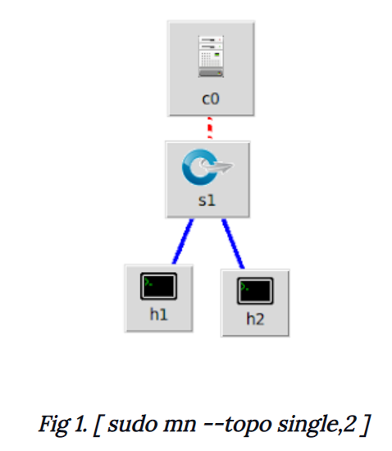
single
single creates a topology with a single switch attached to the number of hosts that are mentioned by the user
sudo mn --topo single,[no_of_hosts]

Slide 11
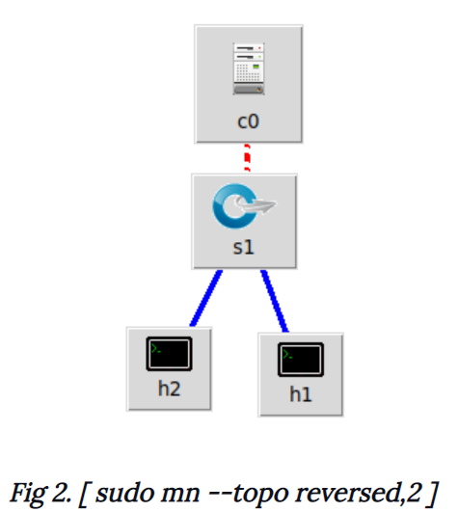
reversed
reversed creates a topology similar to the single command but the interfaces are assigned in a reverse order
sudo mn --topo reversed,[no_of_hosts]

Slide 12
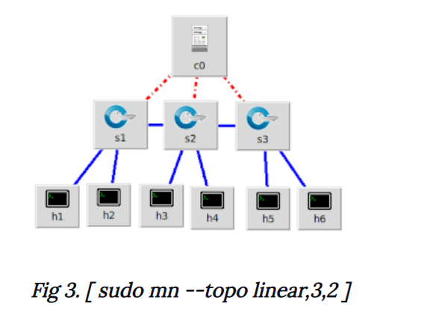
linear
The linear keyword creates a linear topology with the specified number of switches and hosts
sudo mn --topo linear,[no_of_switches],[no_of_hosts_for_each_switch]

Slide 13
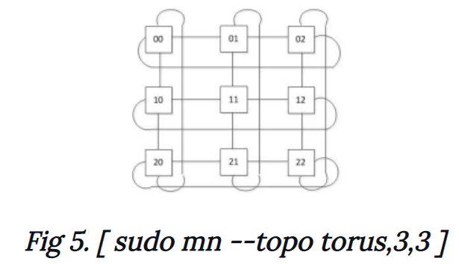
torus
A torus topology can be created using the torus keyword
sudo mn --topo torus,[length],[breadth]

Slide 14
Mininet
In the next example, there are 3 hosts connected: h1 – h2 – h3, and h2 is configured as router
Done according to this: http://csie.nqu.edu.tw/smallko/sdn/mininet-operations.htm

Slide 15
#!/usr/bin/python
from mininet.net import Mininet
from mininet.cli import CLI
from mininet.link import Link, TCLink, Intf
from mininet.log import setLogLevel, info
from mininet.node import CPULimitedHost, Host, Node
def myNetwork():
net = Mininet( topo=None,
build=False,
ipBase='10.0.0.0/8',
link=TCLink)
info( '*** Adding controller\n' )
info( '*** Add switches\n')
info( '*** Add hosts\n')
h1 = net.addHost('h1', cls=Host, ip='10.0.10.2', defaultRoute=None)
h2 = net.addHost('h2', cls=Host, ip='10.0.10.1', defaultRoute=None)
h3 = net.addHost('h3’, cls=Host, ip='10.0.20.2', defaultRoute=None)
info( '*** Add links\n')
Link(h1, h2)
Link(h2,h3,intfName1='h2-eth1')
info( '*** Starting network\n')
net.build()
info( '*** Starting controllers\n')
for controller in net.controllers:
controller.start()
info( '*** Starting switches\n')
info( '*** Post configure switches and hosts\n')
CLI(net)
net.stop()
if name == '__main__':
setLogLevel( 'info' )
myNetwork()

Slide 16
THE END
Notes:
Examples
https://www.programcreek.com/python/example/103166/mininet.net.Mininet
https://python.hotexamples.com/examples/mininet.net/Mininet/-/python-mininet-class-examples.html

Slide 17
Help
https://medium.com/@travisdotmedia/what-is-the-slash-notation-at-the-end-of-ip-addresses-8-16-24-d5c50ac57c5
http://mininet.org/walkthrough/
https://github.com/mininet/openflow-tutorial/wiki

